Slide 1
Predicting Satellite Lifetime
Philip R Oglesby

Slide 2
Predicting Satellite Lifetime in GEO
What is Geosynchronous Orbit?
An Earth centered orbit with an orbital period that matches the Earth’s rotation on its axis.

Slide 3
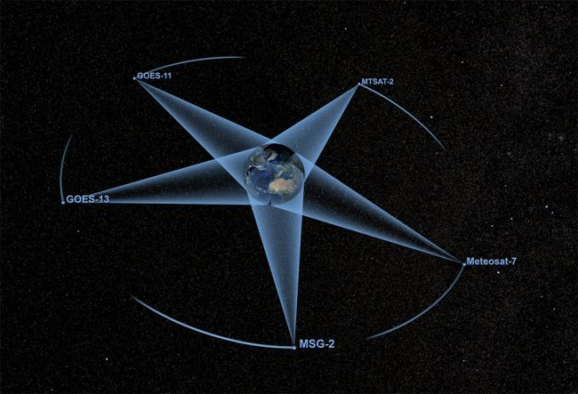
Predicting Satellite Lifetime in GEO
Why are they important?
GEO satellites “stare” at one point on the earth.
There are limited numbers of GEO “slots” for points on the earth.
Usually, they “track” at the equator.
DirecTV, Sirius XM satellites are all in GEO, broadcasting to large parts of the world.

Slide 4
Kaggle: Active Satellites on Orbit
Data was acquired from Kaggle.com, via the Union of Concerned scientists.
Database is a current list of satellites on orbit, but probably not all.
Data is pulled from a variety of sources via commercial, military and academic websites.
The database is probably not 100% accurate as satellites are being launched all the time.
Database contains about 1,420 active satellites on orbit.

Slide 5
Kaggle: Active Satellites on Orbit
Description of Data:
26 Factors, 1420 Observations (active satellites)
Name of Satellite, Country of Registry, Operator/Owner, Country of Operator/Owner, Users, Purpose of Satellite, Detailed Purpose of Satellite (Communications, Earth obs), Class of Orbit (LEO, GEO etc), Longitude of GEO Orbit, Perigee of Orbit, Apogee of Orbit, Eccentricity, Inclination, Orbit Period, Launch Mass (Kg), Dry Mass (Kg), Power (W), Date of Launch, Expected Lifetime (In Years), Contractor, Country of Contractor, Launch Site, Launch Vehicle, COSPAR Number, NORAD Number
Data from https://www.kaggle.com/ucsusa/active-satellites
Data was exported from Kaggle.com as .csv file.

Slide 6
Exploratory Data Analysis

Slide 7
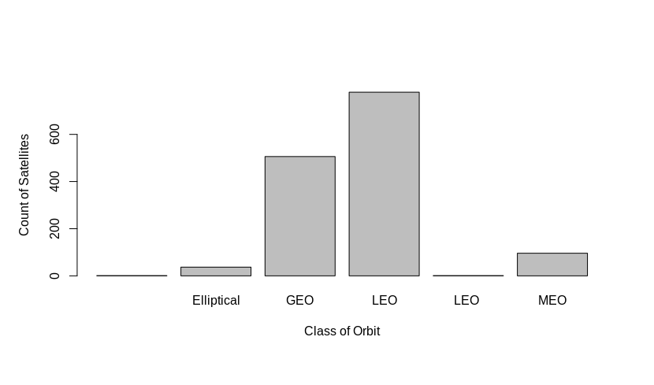
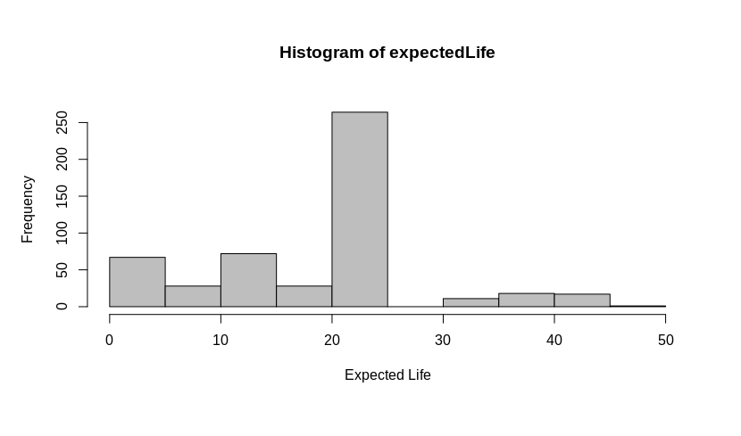
EDA-Class of Orbit and Lifetime
It appears that the lion's share of satellites are in low earth orbit.
Since we are interested in expected life of satellite: (Avg. 17.98, Max = 46, Min = 1) in years.

Slide 8
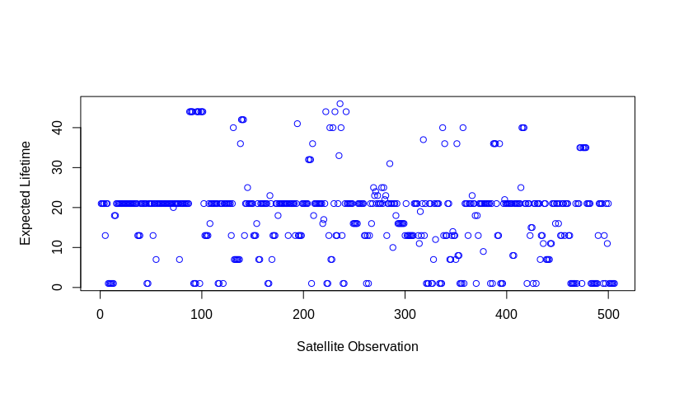
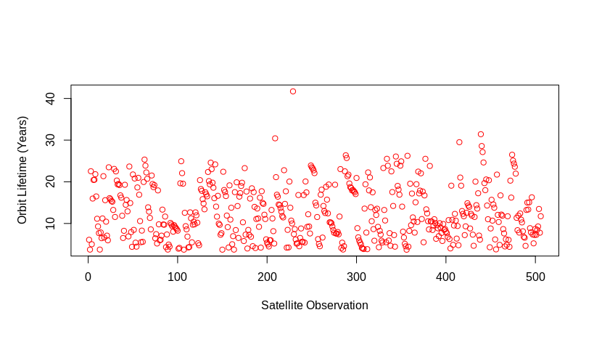
EDA-Subsetting for GEO Orbits
After subsetting Class of Orbit to GEO, we can analyze expected lifetime:
After calculating Orbit lifetime (Today's Date - Date of Launch), we can get a sense of how long on orbit GEO sats have been:
At first glance, the Expected vs. Actual seems close.

Slide 9
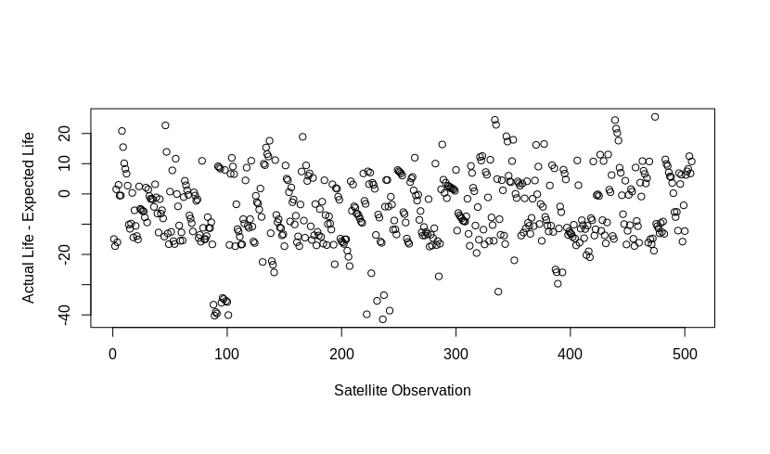
EDA-Difference in Expected vs. Actual Lifetime
For GEO satellites, calculating the difference in Expected Lifetime and Actual Lifetime (as calculated by Today’s Date - Date of Launch)
About 50% didn’t survive to their expected lifetime!

Slide 10
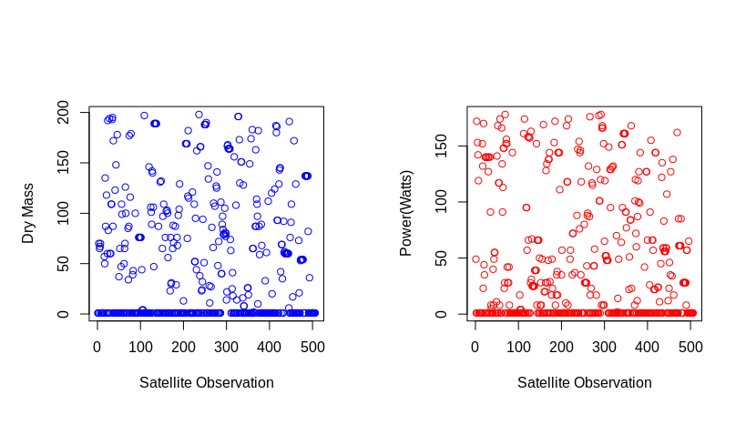
EDA-Power and Size of Vehicle
Power (W) and Dry Mass (kg) can describe the complexity of the satellite:
A great deal of the satellites are 1 W and 1 Kg

Slide 11
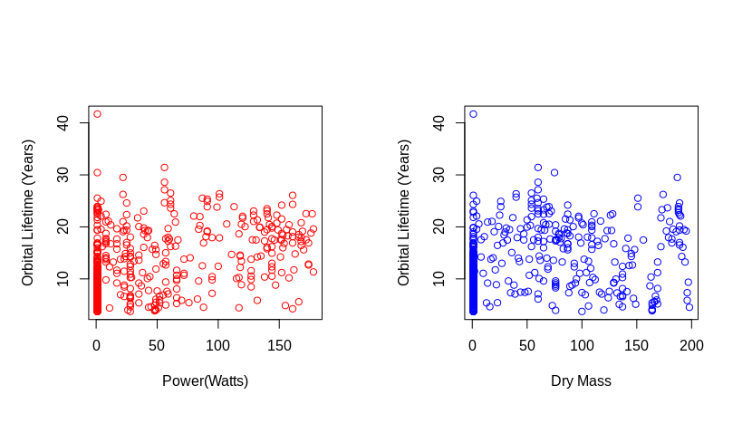
EDA-Power and Size of Vehicle
Now, compare the orbital lifetime vs. Power and Dry Mass
Seems like a somewhat linear relationship for both!

Slide 12
Modeling/Evaluation

Slide 13
Modeling/Eval-Subsetting to Factors of Interest
From larger GEO data set, the data set was reduced from 26 to 10 Factors believed to be relevant:
Longitude of GEO Orbit
Perigee (Km)
Apogee (Km)
Eccentricity (unitless)
Inclination (degrees)
Period (Minutes)
Launch Mass (Kg)
Dry Mass (Kg)
Power (W)
Orbital Lifetime (Years)

Slide 14
Modeling/Eval-Waterfall Table for Data Reduction
Significant subsetting was done to reduce the data for prediction:
Change | Records | Percent
Initial | 36920 | 57.7%
Added Orbital Lifetime | 1420 | 2.2%
Added Design Margin | 1420 | 2.2%
Selected Quantitative Factors | 14200 | 22.2%
Subset for Sats in GEO | 5060 | 7.9%
Removed NULL Values | 4930 | 7.7%
Total | 63950 | 100.0%

Slide 15
Modeling/Eval-Test and Training
Roughly 50/50 Split between test and training data
Randomly sampled using sample(c(TRUE,FALSE), numrow(dataSet), rep = TRUE)
This was recommended from ISLR.
Test | Training
50% | 50%

Slide 16
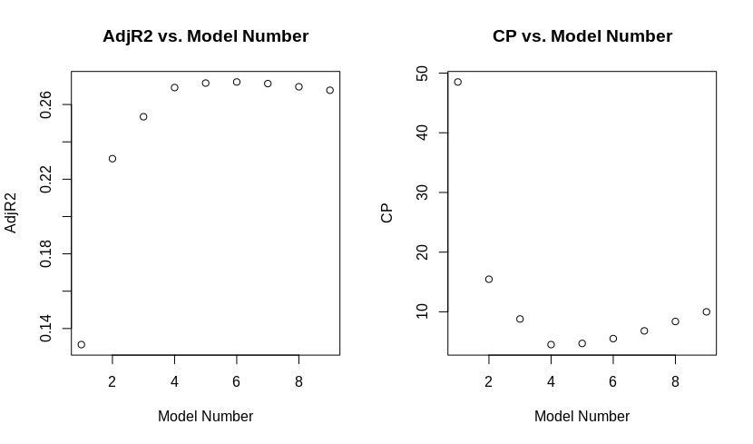
Modeling/Eval-Best Subset Selection
Best subset selection was used on the training data set to determine the best factors to include in a linear model with Adjusted R2 and CP as criteria from the training data:
At first glance, Model #4 has a low Cp and the Adjusted R2 flattens out.

Slide 17
Modeling/Eval-Candidate Models
Best model by both Cp and Adjusted R2 was a linear model with 5 predictors:
Orbitlifetime ~ Longitude of GEO + Dry Mass + Launch Mass + Power
Adjusted R2 is still only 0.269, so the linear model is predicting about 27% of the variation in the data.
Next “best” model by Adjusted R2 is:
Orbitlifetime ~ Longitude of GEO + Inclination + Dry Mass + Launch Mass + Power
Adjusted R2 is 0.271, so marginally better than model #4.

Slide 18
Modeling/Eval-Contextual Analysis
Orbitlifetime ~ Longitude of GEO + Dry Mass + Launch Mass + Power
Conceptually, this model makes a great deal of sense as dry mass, power, and launch mass all describe the size and scope of the satellite, while longitude describe the location of the satellites orbit.
Orbitlifetime ~ Longitude of GEO + Inclination + Dry Mass + Launch Mass + Power
The same can be said for this model with the exception of orbit inclination. Inclination is the “tilt” of the orbit from earth’s equator, so it likely doesn’t give much information about the orbit.

Slide 19
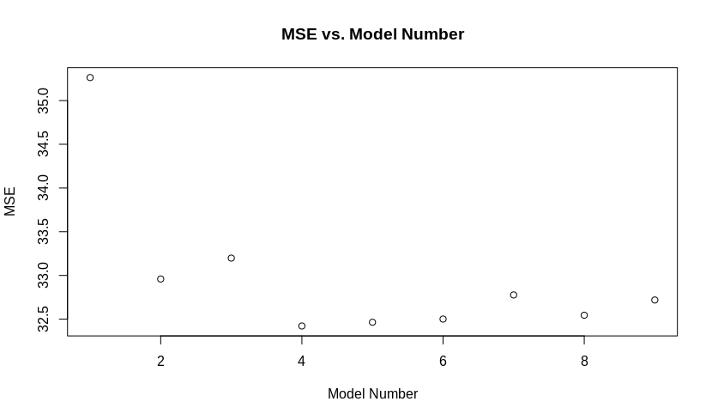
Modeling/Eval-Conclusion from Test Data
Based upon the test data (about 50% randomly sampled),
MSE was calculated against the test set as shown below:
Model 4 is the lowest MSE and the “best” model for prediction.

Slide 20
Model Improvement

Slide 21
Model Improvement-Ridge and Lasso, Clean Data
Cleaning up all the “1” data points. Likely default values in the data set and skewing the data.
Ridge and Lasso regression could be useful as an alternative to model selection for determining which factors are more important.
Adjusting training/test set data from 50/50 split to 80/20 might have an effect on the model as well.

Slide 22
Questions?

